Slide 1
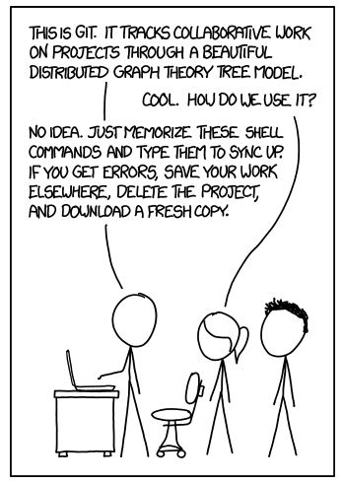

5 minute introduction to Git
https://xkcd.com/1597/

Slide 2
What is it?
Version control
  Keeps a history of changes to a file
  Get back old verisons
  Compare differences
Collaborative Development
  Share files with other people
  Merge work together
Synchronise work on different computers

Slide 3
Install git
Run the “git” command from the command line.
Should be installed on Linux and Mac
On windows use “Git Bash” from https://gitforwindows.org/
There’s lots of GUIs for Git too, we’ll just use the command line today.
  If you understand how to use the command line the GUIs should be easy.

Slide 4
The Git workflow
Initialise a repository
Add files to the repository
Commit changes to those files
Push/pull changes to/from a remote repository

Slide 5
Git init
Creates a new git repository in the current directory.
Create an empty directory for your git repository:
mkdir git-workshop
Change to the new directory
cd git-workshop
Initialise a git repository
git init

Slide 6
Git add
Marks a file as being ready to be “comitted” to git’s history
Create a file first by using your favourite text editor.
Run the command:
git add <filename>

Slide 7
Git commit
Saves a change into git’s history
Asks for a comment describing what you changed
Usage:
git commit <filename>
Or
git commit -a
Or
git add <filename>
git commit
Commits are only saved locally

Slide 8
Commit messages
When you run git commit it will open your default text editor.
You should type a comment about what you’ve changed on the first line of this.
The default text editor might be vi.
  Press ‘i’ to enter insert mode to type text
  Type your message
  Press escape to get to command mode
  Type ‘:wq’ to save the commit message and quit vi.

Slide 9
Remote Repositories
Everything so far is only saved locally
Remote repositories:
  Copy of the repository on another computer
  Access via SSH (key file) or HTTPS (password)
“Clone” a repository to take an initial copy of it
  git clone https://<repository address>
  Or
  git clone username@hostname:<path> (ssh)

Slide 10
Git push/pull
Commits can be “pushed” to a remote git repository
You can also “pull” other people’s changes from a remote repository
If local and remote changes exist you have to pull first.
Must have a remote configured through the git remote command.

Slide 11
Try it for yourselves!
https://abersailbot.co.uk/intro/git
Signup to github.com
Tell us your username on Discord
  We will add you to the Abersailbot git organisation

